Slide 1
The Brain
Views from the top and the bottom
Learning and Memory

Slide 2
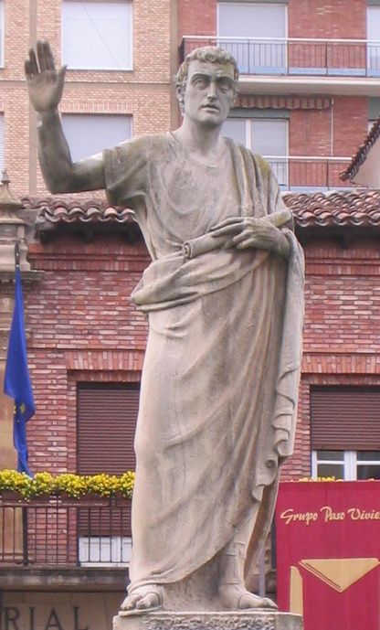
Spanish Roman orator Marcus Fabius Quintilianus: “… curious fact … that the interval of a single night will greatly increase the strength of the memory … the power of recollection … undergoes a process of ripening and maturing during the time which intervenes”

Slide 3
The process of memory maturation where time intervenes was named two thousand years later as memory consolidation.

Slide 4
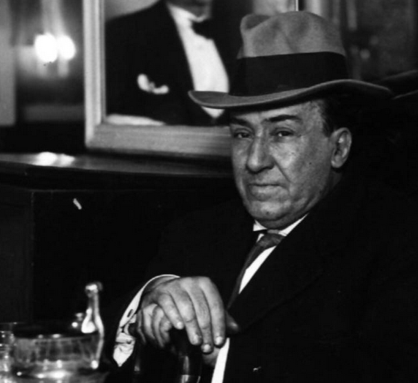
Vivir es desatinar, To live is to wander
tener para destejer, unravel the woven
aprender para olvidar, forget the learned
amar para recordar and love so we remember

Slide 5
The Problem
A fundamental objective of neuroscience is to understand how brains produce the learned or adaptive behaviors that allow animals to thrive in complex environments.
The main idea is that learning is associated with permanent experience-driven changes to animals’ brains that later aid them in the performance of important tasks such as the acquisition of food and shelter while avoiding injury or predation.
From NeuronPerspectiveThe Consolidation and Transformation of MemoryYadin Dudai, Avi Karni, and Jan Born. See accompanying references.

Slide 6
The First Seconds of Systems Consolidation
How does consolidation start? Quite a lot is known on the processes that trigger synaptic consolidation and involve stimulus-induced modulation of gene expression (Kandel et al., 2014).

Slide 7
Properties of Consolidation
Binding separate episodic events in cohesive units.
Modifying existing memories without erasing or overwhelming the brain with useless information.

Slide 8
The status of the field
Memory consolidation is a hypothesis about a group of processes that occur when the animal is awake and asleep, at several levels of complexity from the bottom, as in LTP or LTD and encompassing a range of time scales from milliseconds to years. The fast molecular events are functions of a larger program usualy referred to as SYSTEMS CONSOLIDATION.
Systems consolidation is a dynamic transformation that balances the need to remember some elements and forget others.
The kinetics of consolidation is dependent of the dissonance of new information and the stored information.

Slide 9
Reconsolidation
There also appears to be processes of reconsolidation during which the memory is liable.
This may be a way to treat PTSD.

Slide 10
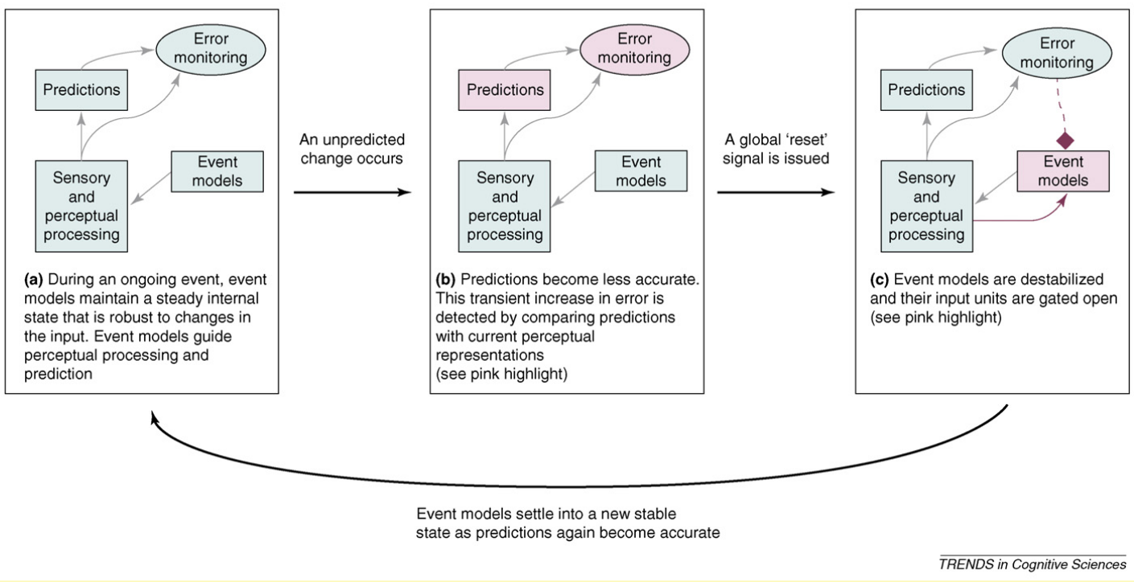
Error Signal in Consolidation
From Kurby, C.A., and Zacks, J.M. (2008). Segmentation in the perception and
memory of events. Trends Cogn. Sci. 12, 72–79

Slide 11
Hippocampus and Associate Areas in Memory Consolidation
A large number of human neuroimaging studies find that the hippocampus is involved in the binding of separate episodic elements into cohesive units.
In rodents, at the offset of a learning trial, the hippocampus showed rapid forward and reverse replay of the firing sequence that occurred during the trial to promote binding of episodic sequences.

Slide 12
Human Studies
Nonetheless, even in the absence of human cellular data, the available fMRI results suggest that the offset-locked hippocampal response may underlie episodic binding, potentially triggered by the occurrence of an event boundary.

Slide 13
Segmentation of Events
Imagine walking with a friend to a coffee shop. If asked to describe this activity in more detail you might list a few of the events that make it up. The events listed could be broken up by changes in the physical features of the activity, such as location: ‘We started out by going down to the laboratory. We grabbed our coats and put them on.
Then we walked out of the building to the corner by the subway station. . .’ Or, they could be broken up by changes in conceptual features, such as your goals: ‘We started our walk talking about how much construction is going on. When the topic turned to the new building with the coffee shop we decided to head over there to give it a try. . .’
Dudai, Y., and Eisenberg, M. (2004). Rites of passage of the engram: reconso-
lidation and the lingering consolidation hypothesis. Neuron 44, 93–100.
Zacks, J.M. et al.(2007) Event perception: A mind/brain perspective. Psychol. Bull. 133, 273–293

Slide 14
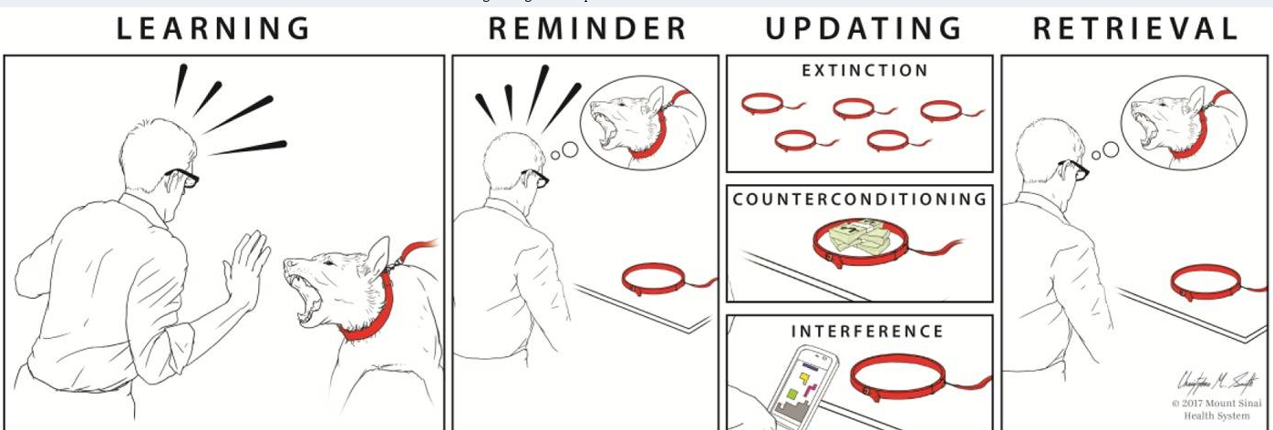
A hallmark of consolidation is the transient susceptibility of the memory to amnesic agents, including retroactively interfering stimuli
Lee et al. Trends Cogn Sci. 2017 Jul; 21(7): 531–545.

Slide 15
The Next Stage: Consolidation in minutes and hours
In both animal and human experiments, it has been shown that within minutes after encoding, specific neocortical regions are engaged in processing. These activations predict or are obligatory for memory consolidation.

Slide 16
How About Hours to Days
The process of memory consolidation over longer time scales is bound to involve sleep.
In recent years, our understanding of the processes and mechanisms of consolidation in was advanced by studies of the role of sleep in memory
The replay of memories during sleep involve SWS, slow-wave sleep.

Slide 17
Location of Activation during Sleep
The reactivation of neuronal ensembles is not restricted to the hippocampus, but spreads beyond extra-hippocampal areas to the striatum and neocortex.

Slide 18
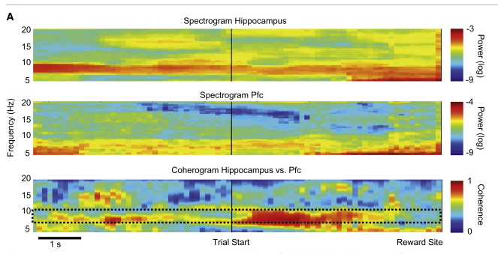
Communication Between These Areas Involves Coherence

Slide 19
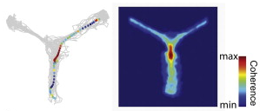
Increased Coherence Between Hip and PFC in a Radial Maze

Slide 20
Phase Amplitude Coupling (PAC) of Signals Between Areas of the Brian in Communication
What is PAC you say?
Well..

Slide 21
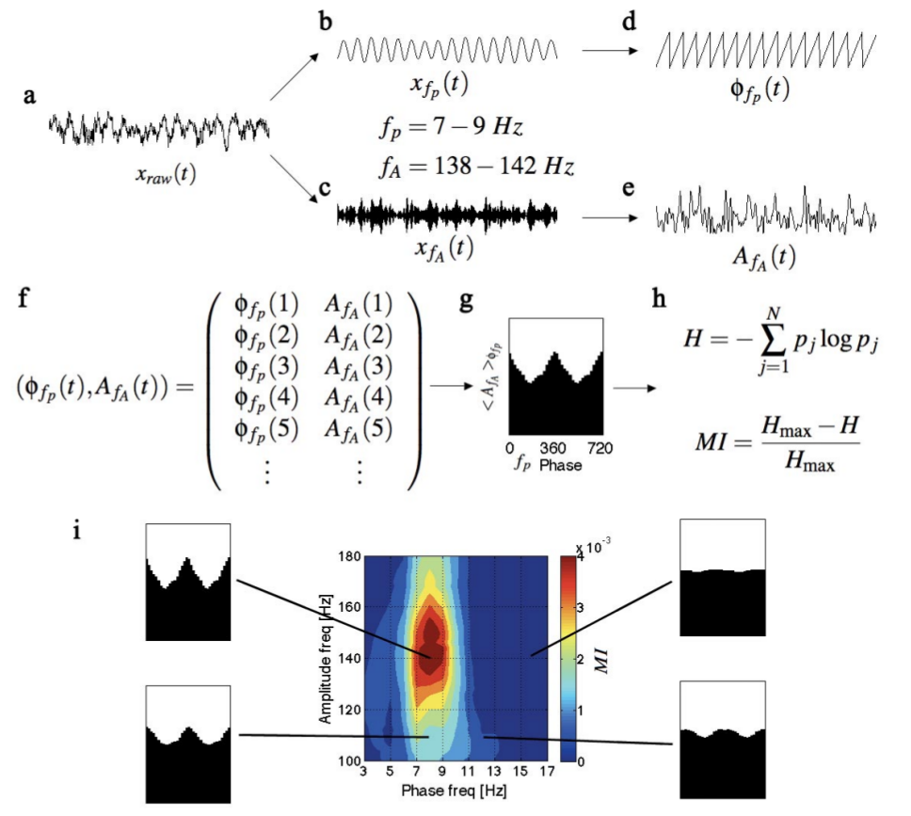
PAC
Tort, PNAS 2008. and personal comm

Slide 22
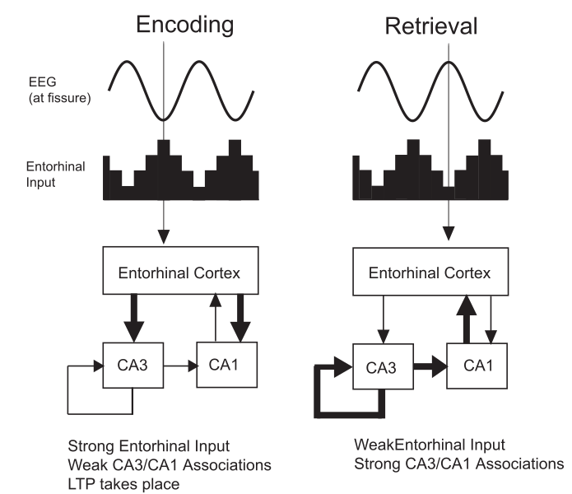
Phase Modulation Has Been Proposed to Play a Role in Encoding and Retrieval in Hip.

Slide 23
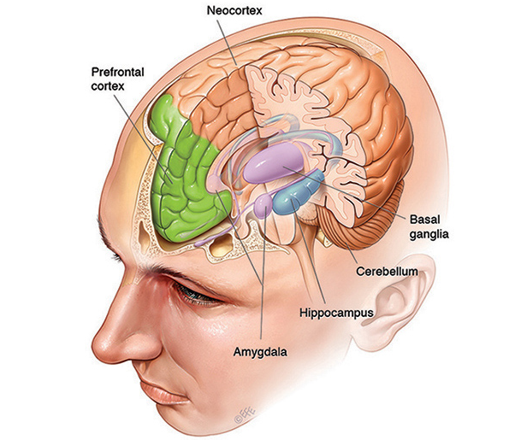
The Hippocampus

Slide 24
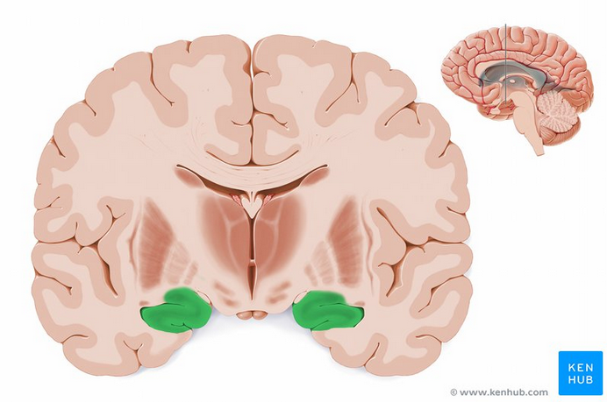

Slide 25
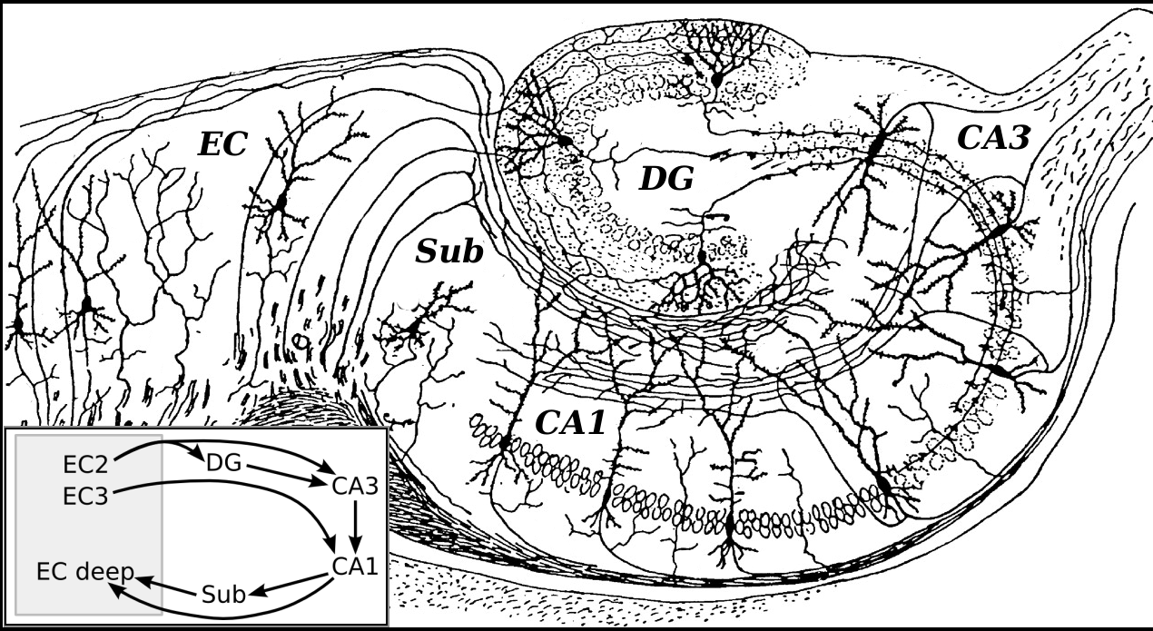

Slide 26
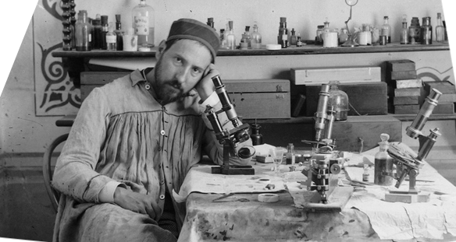
Santiago Ramon y Cajal

Slide 27
Unstable dendritic synapses to stable memory systems?
An enduring focus in the study of the molecular biology of memory storage has been in the search for mechanisms which allow a LTM to persist. Many of the transcriptional events and post-translational modifications of proteins are short-lived (i.e., on the order of a few hours to days). This raises the challenging question: How is a LTM maintained in synaptic connections that are so dynamic in a manner that allows a memory to persist throughout the life-span of an organism?

Slide 28
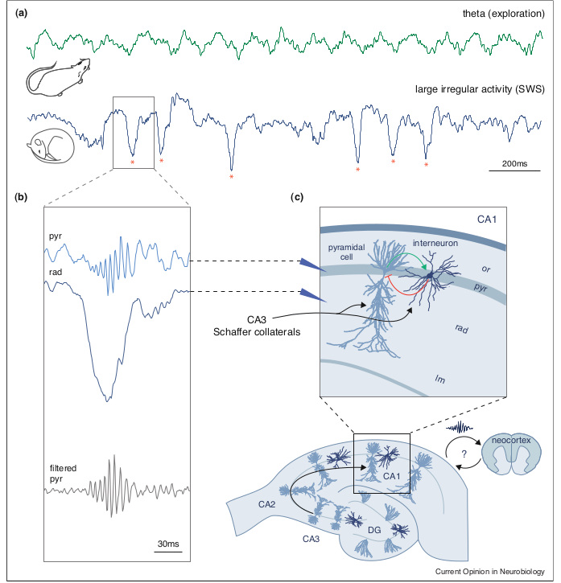

Slide 29
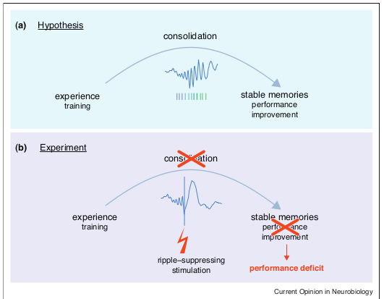
Electrical Interference with CA1 spindle interferes with consolidation

Slide 30
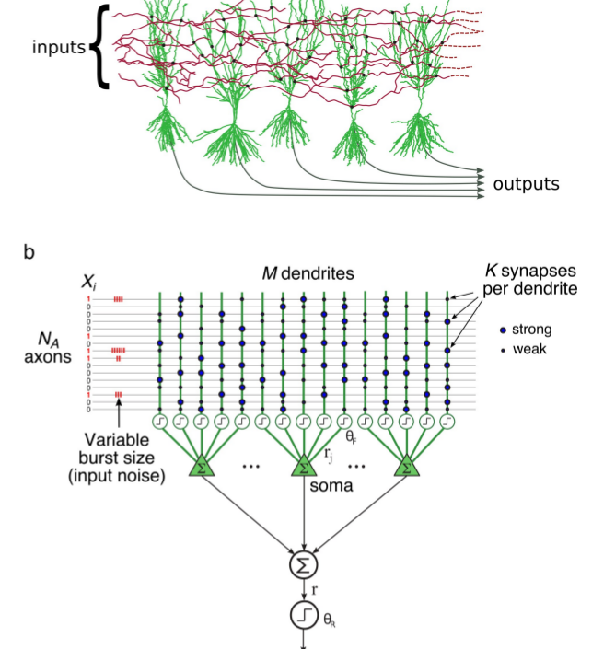
Indexing in Memory Circuits

Slide 31
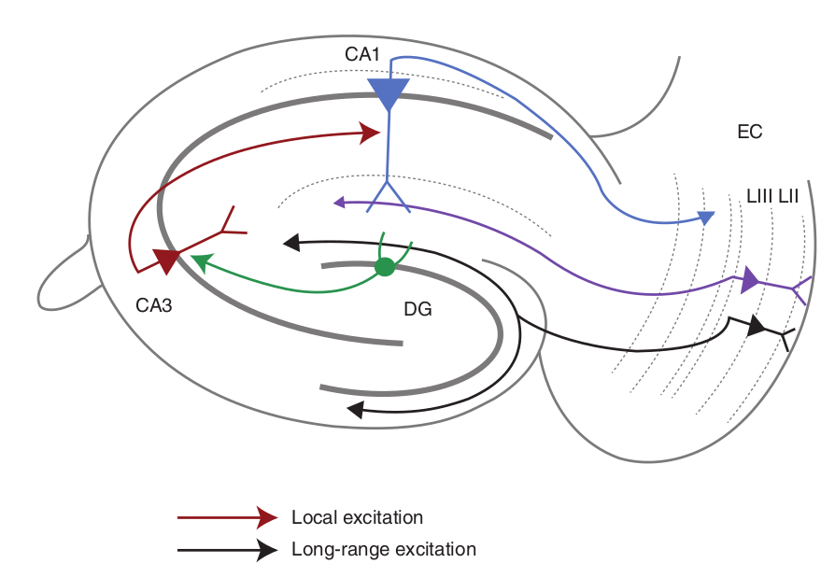
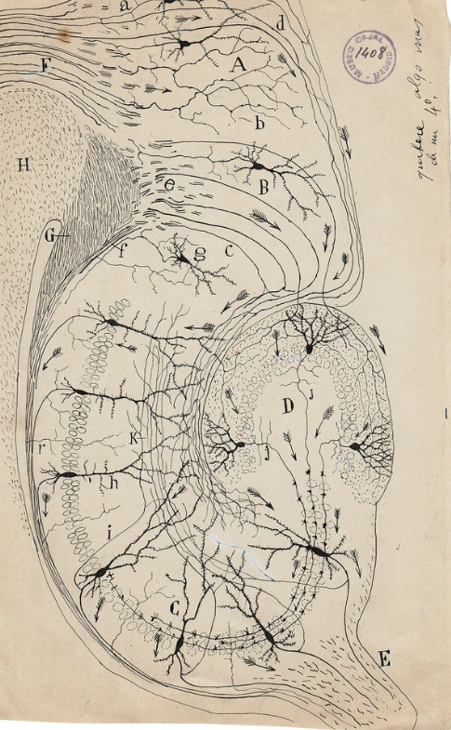
Classical Hippocampal Circuit

Slide 32
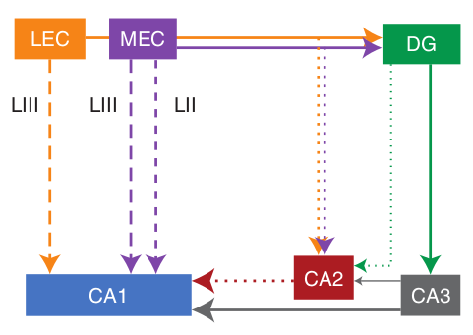
Updated Hippocampal Circuit

Slide 33
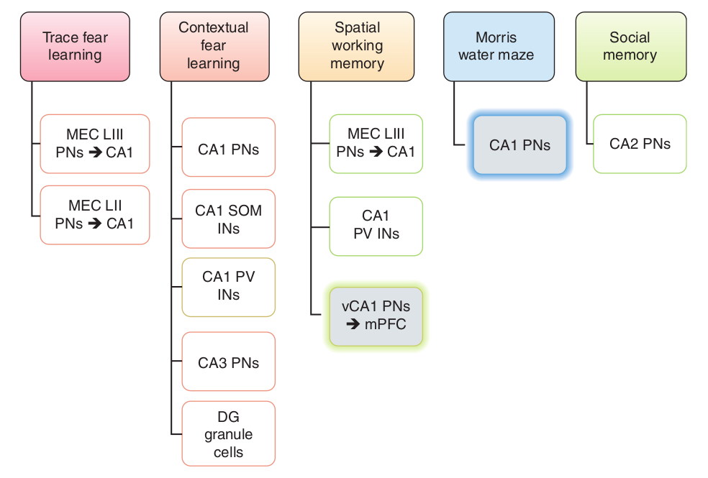
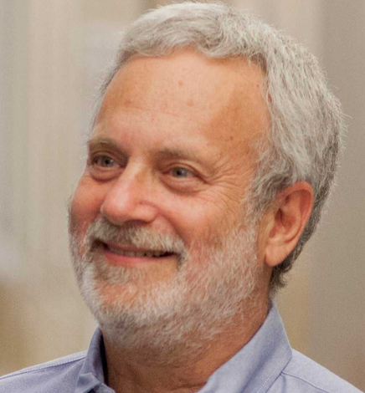
Discovered the Role of CA2 in Social Memories
Steve Siegelbaum Columbia U.
PV=Parvalbumin interneuron
SOM=somatostatin interneuron

Slide 34
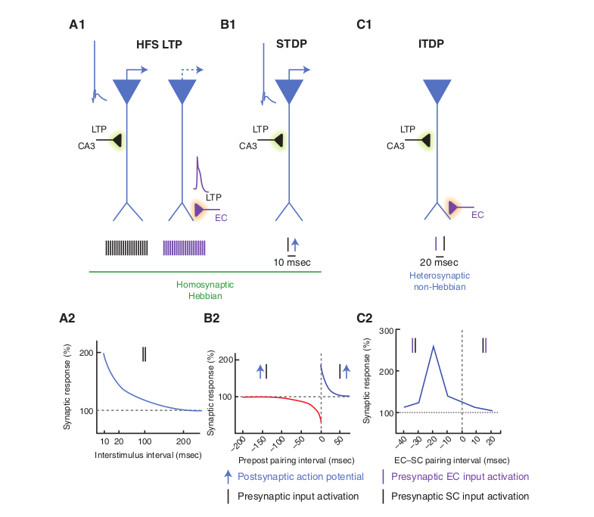
From Classical Hebbian LTP to New Forms of Synaptic Modulation

Slide 35
Dendritic Integration in CA1 Neurons
The process by which synaptic inputs separated in time and space are integrated by the dendritic arbor to produce a sequence of action potentials is among the most fundamental signal transformations that takes place within the central nervous system
Srinivas KV, Buss EW, Sun Q, et al. The Dendrites of CA2 and CA1 Pyramidal Neurons Differentially Regulate Information Flow in the Cortico-Hippocampal Circuit. J Neurosci. 2017;37(12):3276-3293.

Slide 36
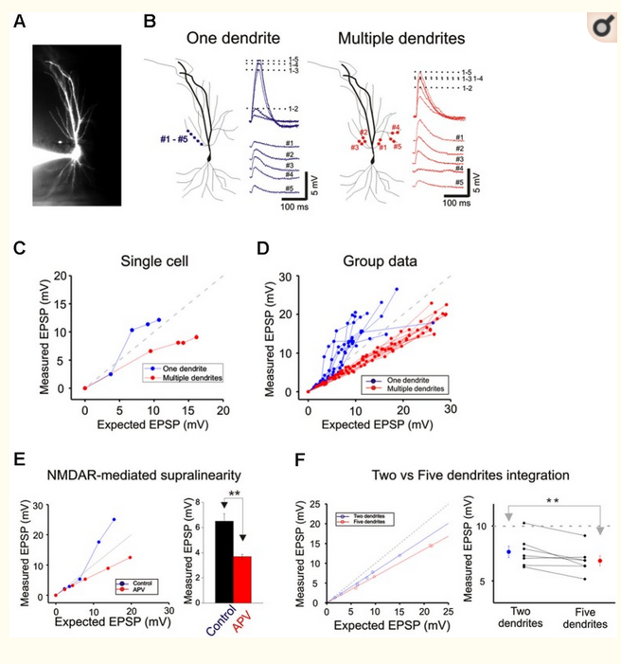
Summation in Oblique Dendrites

Slide 37
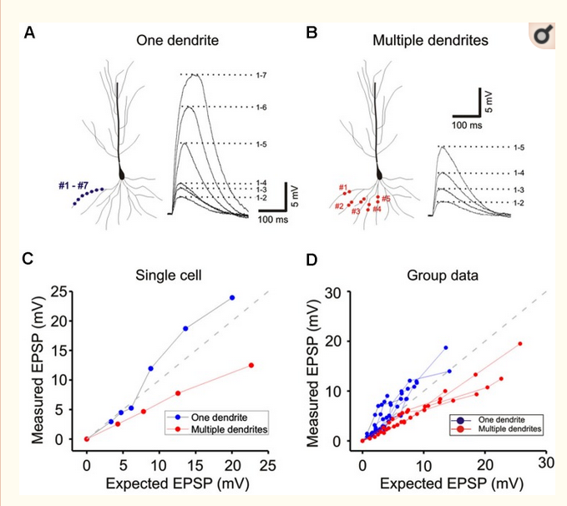
Summation from Basal Dendrites

Slide 38
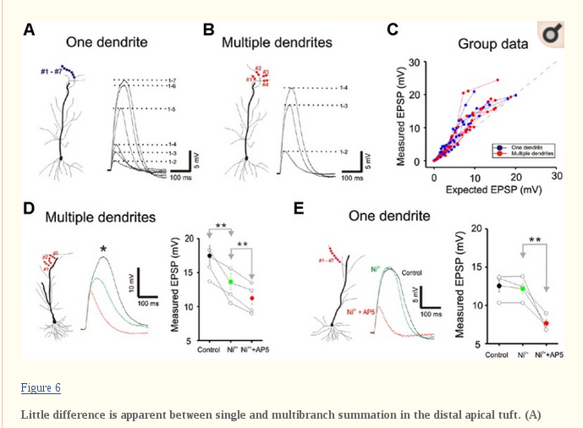
Summation in Distal Dendrites

Slide 39
Summary
The process of Systems Consolidation occurs over time scales spanning seconds to decades
In Systems Consolidation information is exchanged by several areas of the brain, including the hippocampus and the neocortex
Frequency and phase coherence are an important components of the exchange of information
The interconnectivity of the hippocampus and broader connection to broader cortical areas are crucial for the exchange of information
The biophysical properties of CA neurons are important for memory indexing
Dendritic integration is an important component of information processing in the hippocampus

